Slide 1

About the Presentations
The presentations cover the objectives found in the opening of each chapter.
All chapter objectives are listed in the beginning of each presentation.
You may customize the presentations to fit your class needs.
Some figures from the chapters are included. A complete set of images from the book can be found on the Instructor Companion Site.
Notes:
About the Presentations
The presentations cover the objectives found in the opening of each chapter.
All chapter objectives are listed in the beginning of each presentation.
You may customize the presentations to fit your class needs.
Some figures from the chapters are included. A complete set of images from the book can be found on the Instructor Resources disc.

Slide 2
A+ Guide to IT Technical Support, 9th Edition
Chapter 1
First Look at Computer Parts and Tools
Notes:
A+ Guide to IT Technical Support, 9th Edition
Chapter 1
First Look at Computer Parts and Tools

Slide 3
Objectives
Identify the various parts inside a desktop computer case and describe how they connect together and are compatible
Identify the various ports, slots, and internal components of a laptop computer and explain special concerns when supporting and maintaining laptops
Notes:
Objectives
Identify the various parts inside a desktop computer case and describe how they connect together and are compatible
Identify the various ports, slots, and internal components of a laptop computer and explain special concerns when supporting and maintaining laptops

Slide 4
Objectives
Describe various hardware components in mobile devices and types of wired and wireless connections mobile devices can make
Describe the purpose of various tools you will need as a computer hardware technician
Notes:
Objectives
Describe various hardware components in mobile devices and types of wired and wireless connections mobile devices can make
Describe the purpose of various tools you will need as a computer hardware technician

Slide 5
What’s Inside the Case
Computer Case
Sometimes called “chassis”
Holds
Power supply, motherboard, processor, memory modules, expansion cards, hard drive, optical drive, other drives
Tower case – sits upright and can hold several drives
Desktop case – lies flat and sometimes holds monitor
Mobile case – used with laptops and tablets
All-in-one case – used with all-in-one computer
Notes:
What’s Inside the Case
Computer Case
Sometimes called “chassis”
Holds
Power supply, motherboard, processor, memory modules, expansion cards, hard drive, optical drive, other drives
Tower case – sits upright and can hold several drives
Desktop case – lies flat and sometimes holds monitor
Mobile case – used with laptops and tablets
All-in-one case – used with all-in-one computer

Slide 6
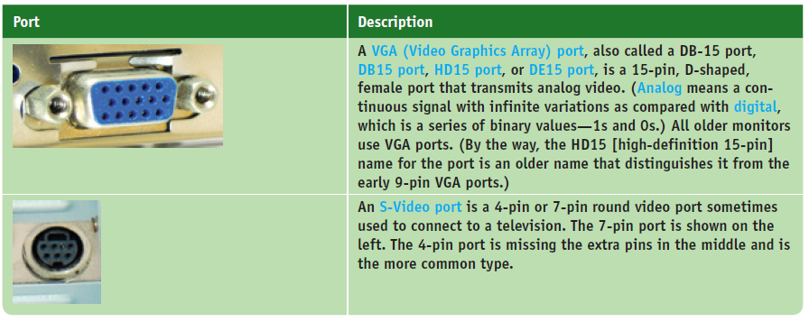
What’s Inside the Case
Table 1-1 Ports used with desktop and mobile computers
Notes:
What’s Inside the Case
Computer Case
Sometimes called “chassis”
Holds
Power supply, motherboard, processor, memory modules, expansion cards, hard drive, optical drive, other drives
Tower case – sits upright and can hold several drives
Desktop case – lies flat and sometimes holds monitor
Mobile case – used with laptops and tablets
All-in-one case – used with all-in-one computer

Slide 7
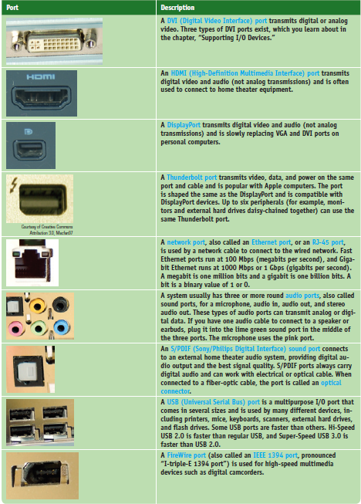
What’s Inside the Case
Table 1-1 Ports used with desktop and mobile computers (continued)
Notes:
What’s Inside the Case
Computer Case
Sometimes called “chassis”
Holds
Power supply, motherboard, processor, memory modules, expansion cards, hard drive, optical drive, other drives
Tower case – sits upright and can hold several drives
Desktop case – lies flat and sometimes holds monitor
Mobile case – used with laptops and tablets
All-in-one case – used with all-in-one computer

Slide 8
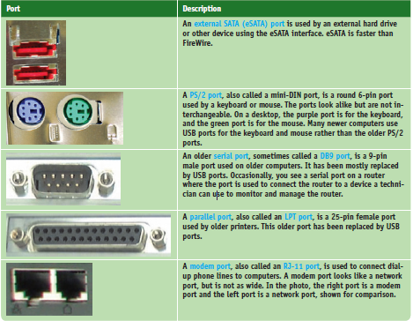
What’s Inside the Case
Table 1-1 Ports used with desktop and mobile computers (continued)
Notes:
What’s Inside the Case
Computer Case
Sometimes called “chassis”
Holds
Power supply, motherboard, processor, memory modules, expansion cards, hard drive, optical drive, other drives
Tower case – sits upright and can hold several drives
Desktop case – lies flat and sometimes holds monitor
Mobile case – used with laptops and tablets
All-in-one case – used with all-in-one computer

Slide 9
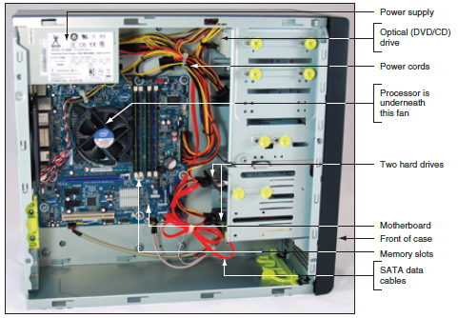
What’s Inside the Case
Figure 1-2 Inside the computer case
Notes:
What’s Inside the Case
Computer Case
Sometimes called “chassis”
Holds
Power supply, motherboard, processor, memory modules, expansion cards, hard drive, optical drive, other drives
Tower case – sits upright and can hold several drives
Desktop case – lies flat and sometimes holds monitor
Mobile case – used with laptops and tablets
All-in-one case – used with all-in-one computer

Slide 10
What’s Inside the Case
Motherboard – sometimes called system board
Largest and most important circuit board
Processor – central processing unit (CPU)
Processes most of the data and instructions for the entire system
CPUs generate heat and require a heat sink and fan (together called the processor cooler)
A heat sink consists of metal fins that draw heat away from a component
Notes:
What’s Inside the Case
Motherboard – sometimes called system board
Largest and most important circuit board
Processor – central processing unit (CPU)
Processes most of the data and instructions for the entire system
CPUs generate heat and require a heat sink and fan (together called the processor cooler)
A heat sink consists of metal fins that draw heat away from a component

Slide 11
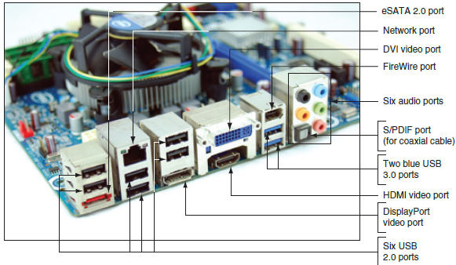
What’s Inside the Case
Expansion cards - also called adapter cards
A circuit board that provides more ports than those provided by the motherboard
Today, most ports are provided by motherboards
Figure 1-4 Ports provided by the motherboard
Notes:
What’s Inside the Case
Expansion cards - also called adapter cards
A circuit board that provides more ports than those provided by the motherboard
Today, most ports are provided by motherboards

Slide 12
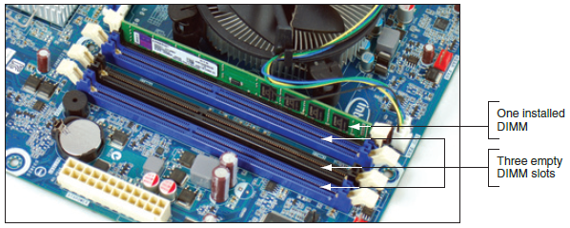
What’s Inside the Case
Memory modules – random access memory (RAM)
Temporary storage for data and instructions as they are being processed by the CPU
Dual inline memory module (DIMM) slots hold memory modules
Figure 1-6 A DIMM holds RAM and is mounted directly on a motherboard
Notes:
What’s Inside the Case
Memory modules – random access memory (RAM)
Temporary storage for data and instructions as they are being processed by the CPU
Dual inline memory module (DIMM) slots hold memory modules

Slide 13
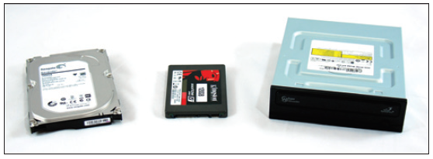
What’s Inside the Case
Hard drives and other drives
Hard drives may also be called hard disk drive (HDD)
Permanent storage used to hold data and programs
Other drives include: optical drive and tape drive
Figure 1-7 Two types of hard drives (larger magnetic drive and smaller solid-state drive) and a DVD drive
Notes:
What’s Inside the Case
Hard drives and other drives
Hard drives may also be called hard disk drive (HDD)
Permanent storage used to hold data and programs
Other drives include: optical drive and tape drive

Slide 14
What’s Inside the Case
Power supply – also called power supply unit (PSU)
Receives and converts house current so that components inside the case can use it
Most come with a dual-voltage selector switch
Allows switching input voltage from 115V to 220V
Notes:
What’s Inside the Case
Power supply – also called power supply unit (PSU)
Receives and converts house current so that components inside the case can use it
Most come with a dual-voltage selector switch
Allows switching input voltage from 115V to 220V

Slide 15
Form Factors Used by Computer Cases, Power Supplies, and Motherboards
Form factors: standards that describe the size, shape, screw hole positions, and major features of computer cases, power supplies, and motherboards
Necessary so that all will be compatible with each other
Two form factors used by most desktop and tower computer cases and power supplies:
ATX
Micro-ATX
Notes:
Form Factors Used by Computer Cases, Power Supplies, and Motherboards
Form factors: standards that describe the size, shape, screw hole positions, and major features of computer cases, power supplies, and motherboards
Necessary so that all will be compatible with each other
Two form factors used by most desktop and tower computer cases and power supplies:
ATX
Micro-ATX

Slide 16
Form Factors Used by Computer Cases, Power Supplies, and Motherboards
ATX (Advanced Technology Extended)
Most commonly used form factor today
Originally developed by Intel in 1995
It is an open, nonproprietary industry specification
An ATX power supply has a variety of power connectors
Power connectors have evolved because new technologies require more power
Common ATX power connectors are listed on the following slides
Notes:
Form Factors Used by Computer Cases, Power Supplies, and Motherboards
ATX (Advanced Technology Extended)
Most commonly used form factor today
Originally developed by Intel in 1995
It is an open, nonproprietary industry specification
An ATX power supply has a variety of power connectors
Power connectors have evolved because new technologies require more power
Common ATX power connectors are listed on the following slides

Slide 17
Form Factors Used by Computer Cases, Power Supplies, and Motherboards
20-pin P1 connector: used by the first ATX power supplies and motherboards
4-pin and 8-pin auxiliary connectors: used to provide and additional 12 V of power for evolving CPUs
24-pin or 20+4-pin P1 connector: the older 20-pin P1 connector still worked in this connector
Supported the new PCI Express slots
6-pin and 8-pin PCIe connectors: connect directly to the video card
Video cards draw the most power in a system
Notes:
Form Factors Used by Computer Cases, Power Supplies, and Motherboards
20-pin P1 connector: used by the first ATX power supplies and motherboards
4-pin and 8-pin auxiliary connectors: used to provide and additional 12 V of power for evolving CPUs
24-pin or 20+4-pin P1 connector: the older 20-pin P1 connector still worked in this connector
Supported the new PCI Express slots
6-pin and 8-pin PCIe connectors: connect directly to the video card
Video cards draw the most power in a system

Slide 18
Form Factors Used by Computer Cases, Power Supplies, and Motherboards
Micro-ATX form factor
Major variation of ATX
Reduces total cost of a system by:
Reducing number of expansion slots on motherboard
Reducing power supplied to the board
Allowing for a smaller case size
Uses a 24-pin P1 connector
Not likely to have as many extra wires and connectors as those on the ATX power supply
Notes:
Form Factors Used by Computer Cases, Power Supplies, and Motherboards
Micro-ATX form factor
Major variation of ATX
Reduces total cost of a system by:
Reducing number of expansion slots on motherboard
Reducing power supplied to the board
Allowing for a smaller case size
Uses a 24-pin P1 connector
Not likely to have as many extra wires and connectors as those on the ATX power supply

Slide 19
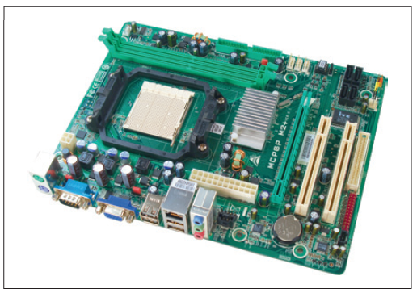
Form Factors Used by Computer Cases, Power Supplies, and Motherboards
Figure 1-17 This microATX motherboard by Biostar is designed to support an AMD processor
Notes:
Form Factors Used by Computer Cases, Power Supplies, and Motherboards
Micro-ATX form factor
Major variation of ATX
Reduces total cost of a system by:
Reducing number of expansion slots on motherboard
Reducing power supplied to the board
Allowing for a smaller case size
Uses a 24-pin P1 connector
Not likely to have as many extra wires and connectors as those on the ATX power supply

Slide 20
Drives, Their Cables, and Connectors
Hard Drives
Two standards:
Serial ATA standard (SATA)
Used by most drives today
Get power from a power cable that connects to the drive using a SATA power connector
Parallel ATA (PATA) – slower than SATA
Also called IDE interface
Used 40-pin ribbon cable and connector
Two connectors on a motherboard for two data cables
Found in most older desktop computers
Notes:
Drives, Their Cables, and Connectors
Hard Drives
Two standards:
Serial ATA standard (SATA)
Used by most drives today
Get power from a power cable that connects to the drive using a SATA power connector
Parallel ATA (PATA) – slower than SATA
Also called IDE interface
Used 40-pin ribbon cable and connector
Two connectors on a motherboard for two data cables
Found in most older desktop computers

Slide 21
First Look at Laptop Computers
Laptop (notebook): portable computer
Variation of a laptop is a netbook
Smaller and has less features than laptop
Comparing laptops to desktop computers
Use the same technology as desktops
Smaller, portable, and use less power
Replacement parts cost more than desktops
Laptops offer a variety of ports and slots
Notes:
First Look at Laptop Computers
Laptop (notebook): portable computer
Variation of a laptop is a netbook
Smaller and has less features than laptop
Comparing laptops to desktop computers
Use the same technology as desktops
Smaller, portable, and use less power
Replacement parts cost more than desktops
Laptops offer a variety of ports and slots

Slide 22
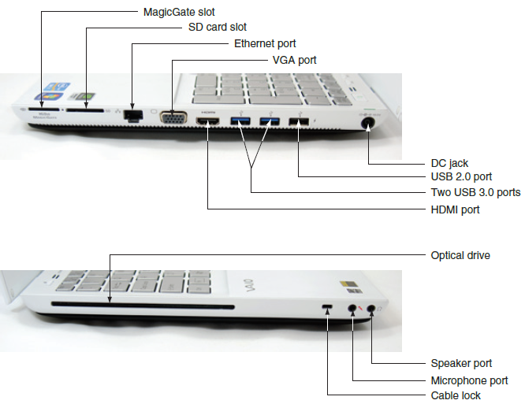
First Look at Laptop Computers
Figure 1-23 Ports and slots on a laptop computer
Notes:
First Look at Laptop Computers

Slide 23
First Look at Laptop Computers
Ports common to laptops include:
USB, FireWire, network, dial-up modem, audio, and video ports
Most laptops include slots for flash memory cards
When a laptop is missing a port or slot, you can use a USB dongle to provide the port or slot
Examples:
USB to RJ-45 dongle to connect to a wired network
USB to Wi-Fi dongle to connect to a wireless network
Notes:
First Look at Laptop Computers
Ports common to laptops include:
USB, FireWire, network, dial-up modem, audio, and video ports
Most laptops include slots for flash memory cards
When a laptop is missing a port or slot, you can use a USB dongle to provide the port or slot
Examples:
USB to RJ-45 dongle to connect to a wired network
USB to Wi-Fi dongle to connect to a wireless network

Slide 24
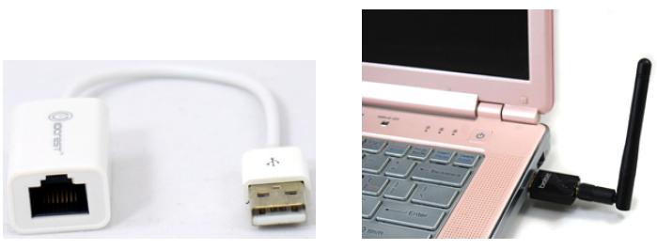
First Look at Laptop Computers
Figure 1-25 USB to RJ-45 dongle provides a network port to connect to a wired network
Figure 1-26 This USB to Wi-Fi adapter plugs into a USB port to connect to a local wireless network
Notes:
First Look at Laptop Computers

Slide 25
Special Keys, Buttons, and Input Devices on a Laptop
Button or switches might be above the keyboard
Most of the same settings that these buttons control may also be changed using Windows tools
Some settings might be:
Volume
Keyboard backlight
Touch pad on or off
Screen brightness and screen orientation
Dual displays
Bluetooth or Wi-Fi
Media options
GPS on or off
Notes:
Special Keys, Buttons, and Input Devices on a Laptop
Button or switches might be above the keyboard
Most of the same settings that these buttons control may also be changed using Windows tools
Some settings might be:
Volume
Keyboard backlight
Touch pad on or off
Screen brightness and screen orientation
Dual displays
Bluetooth or Wi-Fi
Media options
GPS on or off

Slide 26
ExpressCard Slots
Most peripheral devices on today’s laptops use a USB port to connect to a laptop
Before USB, laptops offered ExpressCard slots
Sometimes called PCMCIA cards
ExpressCard matches PCI Express and USB 2.0
Two sizes: ExpressCard/34 and ExpressCard/54
Not backward compatible
Hot-pluggable, hot-swappable, and supports autoconfiguration
Notes:
ExpressCard Slots
Most peripheral devices on today’s laptops use a USB port to connect to a laptop
Before USB, laptops offered ExpressCard slots
Sometimes called PCMCIA cards
ExpressCard matches PCI Express and USB 2.0
Two sizes: ExpressCard/34 and ExpressCard/54
Not backward compatible
Hot-pluggable, hot-swappable, and supports autoconfiguration

Slide 27
ExpressCard Slots
Windows services for ExpressCard
Socket service establishes communication between the card and the laptop
Card service provides the device driver to interface with the card after the socket is created
Removing card from ExpressCard slot
Use the Safely Remove Hardware icon in the notification area to stop one card before inserting another
Proceed to eject the card
Notes:
ExpressCard Slots
Windows services for ExpressCard
Socket service establishes communication between the card and the laptop
Card service provides the device driver to interface with the card after the socket is created
Removing card from ExpressCard slot
Use the Safely Remove Hardware icon in the notification area to stop one card before inserting another
Proceed to eject the card

Slide 28
Docking Stations
Some laptops have a connector called a docking port
A docking station provides ports to allow a laptop to easily connect to a full-sized monitor, keyboard, AC power adapter, and other peripheral devices
To use a docking station:
Plug all peripherals into docking station
Connect laptop to the station
No software needed
Notes:
Docking Stations
Some laptops have a connector called a docking port
A docking station provides ports to allow a laptop to easily connect to a full-sized monitor, keyboard, AC power adapter, and other peripheral devices
To use a docking station:
Plug all peripherals into docking station
Connect laptop to the station
No software needed

Slide 29
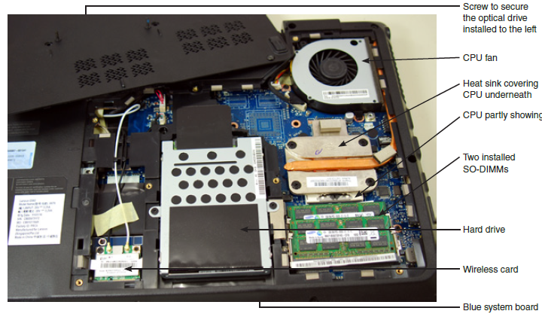
Laptop Internal Components
Figure 1-36 Bottom of a laptop with cover removed
Notes:
Laptop Internal Components

Slide 30
Laptop Internal Components
List of important components:
Battery pack
Hard drive
CPU, heat sink, and fan
Memory
Wireless card
System board
Optical drive
Notes:
Laptop Internal Components
List of important components:
Battery pack
Hard drive
CPU, heat sink, and fan
Memory
Wireless card
System board
Optical drive

Slide 31
What’s Inside an All-in-One Computer
All-in-one computer: uses a mix of components sized for a desktop and a laptop
For some components, you’ll need to buy replacements from the manufacturer because they are most likely proprietary
See the service manual for specific directions about replacing parts
Notes:
What’s Inside an All-in-One Computer
All-in-one computer: uses a mix of components sized for a desktop and a laptop
For some components, you’ll need to buy replacements from the manufacturer because they are most likely proprietary
See the service manual for specific directions about replacing parts

Slide 32
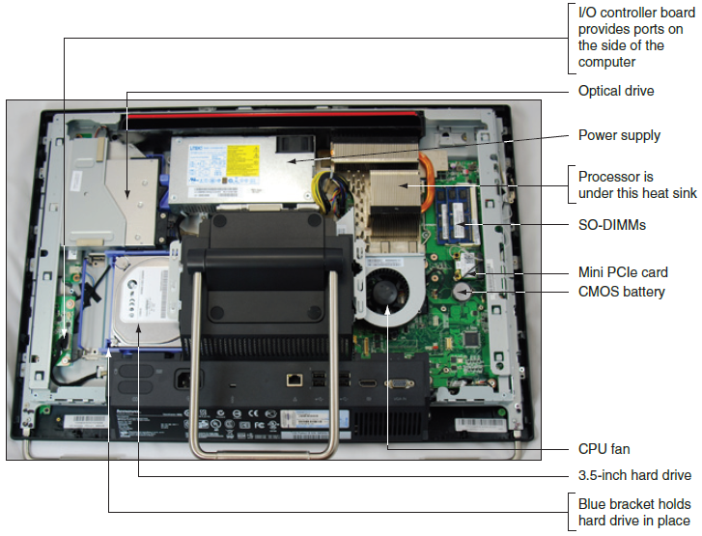
What’s Inside an All-in-One Computer
Figure 1-38 Components inside an all-in-one computer
Notes:
What’s Inside an All-in-One Computer

Slide 33
Maintaining Laptops and Mobile Devices
General guidelines:
Do not touch LCD panel with sharp objects
Do not pick up or hold by the lid
Use OEM recommended battery packs
Do not tightly pack in a suitcase – use carrying case
Do not move while hard drive is being accessed
Do not put close to appliances generating strong magnetic field
Always use passwords to protect your laptop when connected to a public network or if device is stolen
Notes:
Maintaining Laptops and Mobile Devices
General guidelines:
Do not touch LCD panel with sharp objects
Do not pick up or hold by the lid
Use OEM recommended battery packs
Do not tightly pack in a suitcase – use carrying case
Do not move while hard drive is being accessed
Do not put close to appliances generating strong magnetic field
Always use passwords to protect your laptop when connected to a public network or if device is stolen

Slide 34
Maintaining Laptops and Mobile Devices
General guidelines (cont’d):
Keep notebook at room temperature
Keep away from smoke, water, dust
Do not power up and down unnecessarily
Do not run it while it is in the case, resting on pillow or covered by a blanket
Protect notebook against ESD
Remove CD/DVD or USB flash drives before traveling
Take precautions if notebook gets wet
Keep current backups of important data
Notes:
Maintaining Laptops and Mobile Devices
General guidelines (cont’d):
Keep notebook at room temperature
Keep away from smoke, water, dust
Do not power up and down unnecessarily
Do not run it while it is in the case, resting on pillow or covered by a blanket
Protect notebook against ESD
Remove CD/DVD or USB flash drives before traveling
Take precautions if notebook gets wet
Keep current backups of important data

Slide 35
Maintaining Laptops and Mobile Devices
Cleaning tips:
Clean LCD panel with a soft dry cloth
Use compressed air
To clean keyboard, track ball, and touch pad
To blow out air vents
Remove keyboard if keys are sticking and then blow air under keys
Use contact cleaner
Remove battery and clean battery connections
Notes:
Maintaining Laptops and Mobile Devices
Cleaning tips:
Clean LCD panel with a soft dry cloth
Use compressed air
To clean keyboard, track ball, and touch pad
To blow out air vents
Remove keyboard if keys are sticking and then blow air under keys
Use contact cleaner
Remove battery and clean battery connections

Slide 36
First Look at Mobile Device Hardware
A smart phone is a cell phone with added capabilities
Ability to send/receive text messages with photos, video, or other multimedia content
Web browsing
Manage email
Play games
Take photos and video
Use a variety of apps
Notes:
First Look at Mobile Device Hardware
A smart phone is a cell phone with added capabilities
Ability to send/receive text messages with photos, video, or other multimedia content
Web browsing
Manage email
Play games
Take photos and video
Use a variety of apps

Slide 37
First Look at Mobile Device Hardware
Tablet is larger than a smart phone with similar functions
Most connect to Wi-Fi and Bluetooth and some have cellular network connectivity
Some can make phone calls and use MMS
Phablet – same capabilities of a smart phone or tablet
Smaller than a tablet and larger than a smart phone
Notes:
First Look at Mobile Device Hardware
Tablet is larger than a smart phone with similar functions
Most connect to Wi-Fi and Bluetooth and some have cellular network connectivity
Some can make phone calls and use MMS
Phablet – same capabilities of a smart phone or tablet
Smaller than a tablet and larger than a smart phone

Slide 38
First Look at Mobile Device Hardware
Other mobile devices
E-readers
Smart cameras
Wearable technology devices
Smart watches, wristbands, arm bands, eyeglasses, headsets, and clothing
Notes:
First Look at Mobile Device Hardware
Other mobile devices
E-readers
Smart cameras
Wearable technology devices
Smart watches, wristbands, arm bands, eyeglasses, headsets, and clothing

Slide 39
Connection Types
Some ways a mobile device connects to outside world:
Wi-Fi local wireless network and cellular network
Bluetooth and Infrared
Near Field Communication (NFC)
Wired connection
Tethering and mobile hotspots
Notes:
Connection Types
Some ways a mobile device connects to outside world:
Wi-Fi local wireless network and cellular network
Bluetooth and Infrared
Near Field Communication (NFC)
Wired connection
Tethering and mobile hotspots

Slide 40
Connection Types
A mobile device can use the following to sense its position:
Gyroscope or accelerometer
Motion and position sensing device
Helps to adjust screen orientation
Used by games to sense device movement
GPS
Mobile devices might contain a GPS receiver
Routinely reports its position to the owner of the OS
Geotracking: possible for companies to track device’s whereabouts
Notes:
Connection Types
A mobile device can use the following to sense its position:
Gyroscope or accelerometer
Motion and position sensing device
Helps to adjust screen orientation
Used by games to sense device movement
GPS
Mobile devices might contain a GPS receiver
Routinely reports its position to the owner of the OS
Geotracking: possible for companies to track device’s whereabouts

Slide 41
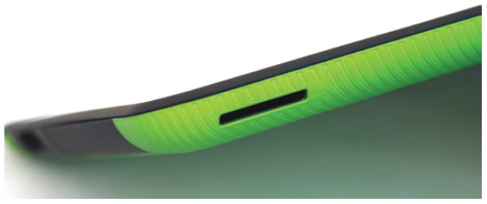
Storage Devices
Mobile devices store apps and data on a solid state drive (SSD)
A type of flash memory
A device might have an external slot for a smart card to provide extra storage
Figure 1-49 An Android device might provide a memory card slot to allow for extra storage
Notes:
Storage Devices
Mobile devices store apps and data on a solid state drive (SSD)
A type of flash memory
A device might have an external slot for a smart card to provide extra storage

Slide 42
Mobile Device Accessories
Examples of accessories:
Wireless keyboards
Speakers
Ear buds
Headsets
Game pads
Docking stations
Printers
USB adapters
Credit card readers
Notes:
Mobile Device Accessories
Examples of accessories:
Wireless keyboards
Speakers
Ear buds
Headsets
Game pads
Docking stations
Printers
USB adapters
Credit card readers

Slide 43
Field-Serviceable Parts for Mobile Devices
There are few FRU in mobile devices
It is possible to replace screens in some mobile devices
A support technician is not generally expected to do this
SIM cards and batteries can be replaced
Notes:
Field-Serviceable Parts for Mobile Devices
There are few FRU in mobile devices
It is possible to replace screens in some mobile devices
A support technician is not generally expected to do this
SIM cards and batteries can be replaced

Slide 44
Tools Used By a Computer Hardware Technician
Essential tools
ESD strap (ground bracelet)
Flat-head screwdriver
Phillips-head or cross-head screwdriver
Torx screwdriver set (size T15)
Insulated tweezers
Extractor
OS recovery CD or DVD
Many other non-essential tools exists
Use a toolbox
Notes:
Tools Used By a Computer Hardware Technician
Essential tools
ESD strap (ground bracelet)
Flat-head screwdriver
Phillips-head or cross-head screwdriver
Torx screwdriver set (size T15)
Insulated tweezers
Extractor
OS recovery CD or DVD
Many other non-essential tools exists
Use a toolbox

Slide 45
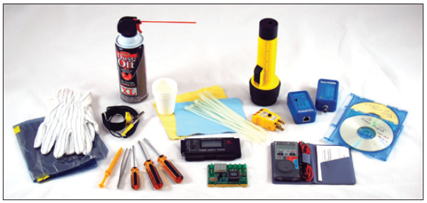
Tools Used By a Computer Hardware Technician
Figure 1-52 Tools used by IT support technicians when maintaining, repairing, or upgrading computers
Notes:
Tools Used By a Computer Hardware Technician
Essential tools
ESD strap (ground bracelet)
Flat-head screwdriver
Phillips-head or cross-head screwdriver
Torx screwdriver set (size T15)
Insulated tweezers
Extractor
OS recovery CD or DVD
Many other non-essential tools exists
Use a toolbox

Slide 46
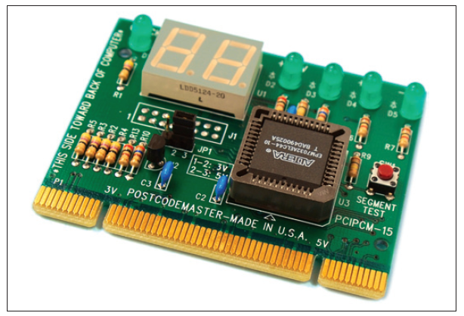
Post Diagnostic Cards
Post Diagnostic Cards
Helps discover, report computer errors and conflicts at power-on self test (POST)
Tests performed by startup UEFI/BIOS
Figure 1-56 Post Code Master diagnostic card by Microsystems Developments, Inc. installs in a PCI slot
Notes:
Post Diagnostic Cards
Post Diagnostic Cards
Helps discover, report computer errors and conflicts at power-on self test (POST)
Tests performed by startup UEFI/BIOS

Slide 47
Post Diagnostic Cards
Firmware – programs and data stored on the motherboard
Two types of firmware may be used:
BIOS (basic input/output system) contains:
System BIOS
Startup BIOS
BIOS setup
UEFI (Unified Extensible Firmware Interface)
More robust and secure than BIOS
Can assure boot is secure and no rogue OS hijacks the system
Notes:
Post Diagnostic Cards
Firmware – programs and data stored on the motherboard
Two types of firmware may be used:
BIOS (basic input/output system) contains:
System BIOS
Startup BIOS
BIOS setup
UEFI (Unified Extensible Firmware Interface)
More robust and secure than BIOS
Can assure boot is secure and no rogue OS hijacks the system

Slide 48
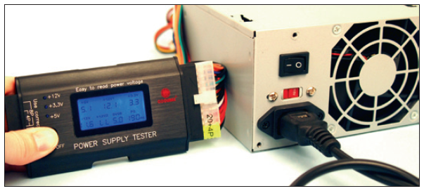
Power Supply Tester
Power Supply Tester
Measures output of each power supply connector
Figure 1-57 Use a power supply tester to test the output of each power connector on a power supply
Notes:
Power Supply Tester
Power Supply Tester
Measures output of each power supply connector

Slide 49
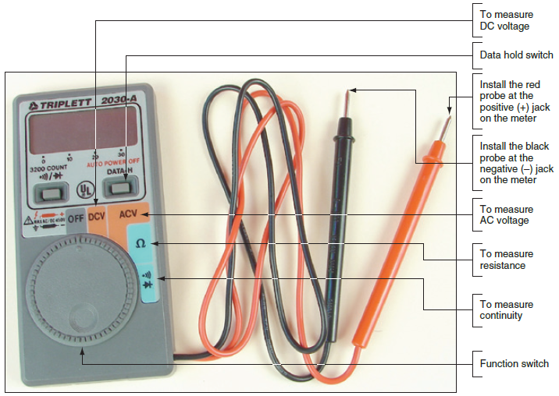
Multimeter
Multimeter
Measures several characteristics of electricity in a variety of devices
Figure 1-58 This digital multimeter can be set to measure voltage, resistance, or continuity
Notes:
Multimeter
Multimeter
Measures several characteristics of electricity in a variety of devices

Slide 50
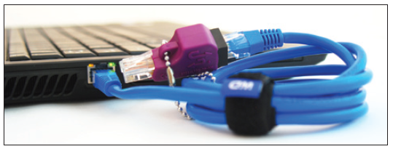
Loopback Plugs
Loopback plug
Used to test a port in a computer or other device to make sure the port is working
May also test the throughput or speed of port
Figure 1-59 A loopback plug testing a network port and network cable
Notes:
Loopback Plugs
Loopback plug
Used to test a port in a computer or other device to make sure the port is working
May also test the throughput or speed of port

Slide 51
Summary
Ports on a computer might include video, RJ-45, audio, S/PDIF, USB, FireWire, eSATA, and PS/2
Internal computer components include the motherboard, processor, expansion cards, DIMM modules, hard drive, optical drive, tape drive, and power supply
Form factors used by cases, power supplies, and motherboards are ATX and micro-ATX
Power connectors include the 20-pin P1, 24-pin P1, 4-pin and 8-pin auxiliary motherboard, 4-pin Molex, 15-pin SATA, 4-pin Berg, and 6/8-pin PCIe
Notes:
Summary
Ports on a computer might include video, RJ-45, audio, S/PDIF, USB, FireWire, eSATA, and PS/2
Internal computer components include the motherboard, processor, expansion cards, DIMM modules, hard drive, optical drive, tape drive, and power supply
Form factors used by cases, power supplies, and motherboards are ATX and micro-ATX
Power connectors include the 20-pin P1, 24-pin P1, 4-pin and 8-pin auxiliary motherboard, 4-pin Molex, 15-pin SATA, 4-pin Berg, and 6/8-pin PCIe

Slide 52
Summary
Most hard drives, optical drives, and tape drives use the serial ATA (SATA) standards
Laptop computers use function keys to control many features of the laptop
A laptop may have an ExpressCard/34 or ExpressCard/54 slot for expansion
Internal laptop components include keyboard, hard drive, memory, smart card reader, optical drive, wireless card, screen, DC jack, battery pack, touch pad, speaker, system board, and CPU, heat sink/fan
Notes:
Summary
Most hard drives, optical drives, and tape drives use the serial ATA (SATA) standards
Laptop computers use function keys to control many features of the laptop
A laptop may have an ExpressCard/34 or ExpressCard/54 slot for expansion
Internal laptop components include keyboard, hard drive, memory, smart card reader, optical drive, wireless card, screen, DC jack, battery pack, touch pad, speaker, system board, and CPU, heat sink/fan

Slide 53
Summary
An all-in-one computer uses a combination of components designed for desktop computers and laptops
Mobile devices an IT support technician may service include smart phones, tablets, phablets, e-readers, smart cameras, GPS devices, and wearable technology devices
A mobile device might make a connection using a cellular network, Wi-Fi network, Bluetooth, IR, NFC, tethering, creating its own hotspot, or a wired connection
Notes:
Summary
An all-in-one computer uses a combination of components designed for desktop computers and laptops
Mobile devices an IT support technician may service include smart phones, tablets, phablets, e-readers, smart cameras, GPS devices, and wearable technology devices
A mobile device might make a connection using a cellular network, Wi-Fi network, Bluetooth, IR, NFC, tethering, creating its own hotspot, or a wired connection

Slide 54
Summary
Common tools for a computer hardware technician include an ESD strap, screwdrivers, tweezers, flashlight, compressed air, and cleaning solutions and pads
Special tools a PC support technician might need include a POST diagnostic card, power supply tester, multimeter, and loopback plugs
Notes:
Summary
Common tools for a computer hardware technician include an ESD strap, screwdrivers, tweezers, flashlight, compressed air, and cleaning solutions and pads
Special tools a PC support technician might need include a POST diagnostic card, power supply tester, multimeter, and loopback plugs

